Slide 1
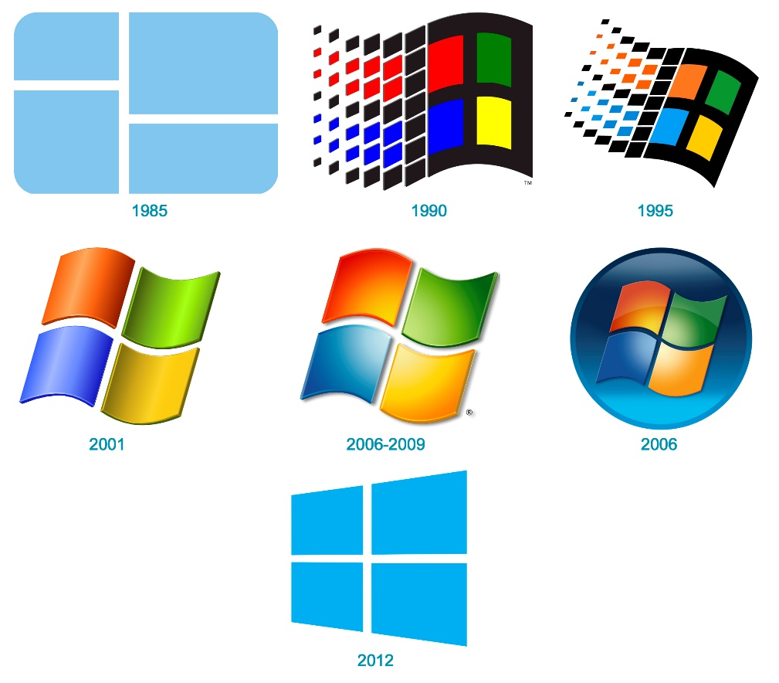

Windows Logs
Mahesh Pavaskar

Slide 2
Content
Why logs are important?
Where logs are stored?
How log looks & important fields in logs
Types of logs?
Possible Data sources based on types of logs
EventViewer
How to send logs towards syslog server / Collector / SIEM
Important EventID in Windows – might be useful to write security use cases

Slide 3
Why logs are important?
To trace the activity
Analyse the logs and identify the suspicious behaviour
Prevent attacker before more damage to organization
Behavioural analysis
Anomaly detection
Outlier

Slide 4
Where logs are stored?
Windows
C:\Windows\System32\winevt\Logs

Slide 5
How log looks & important fields in logs
Original Format : XML
Important Fields
Timestamp, Hostname,EventID,SubjectUser, TargetUser etc
Different Languages
Log sources
Different Words
Different Log format - fields
Express Feelings
Purpose – Security value

Slide 6
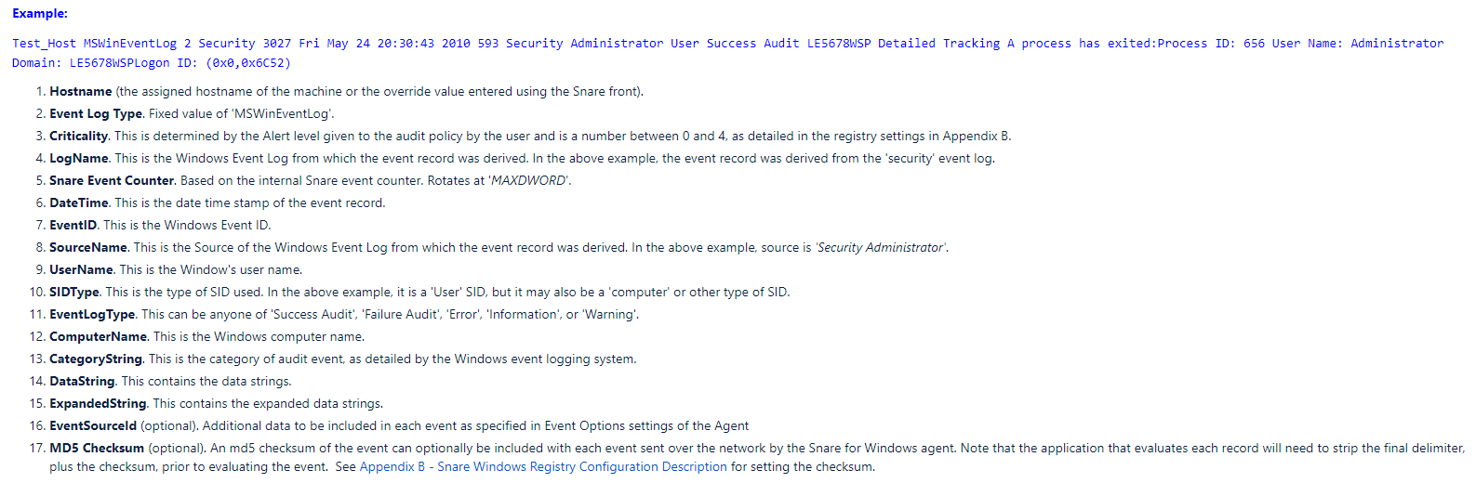
https://prophecyinternational.atlassian.net/wiki/spaces/WADOC/pages/1233224043/Appendix+A+-+Windows+Event+Output+Format

Slide 7
Types of logs?
IIS - App
Application
Win Log Type
Setup
Security
Powershell
System
Sysmon
EDR
FIM

Slide 8
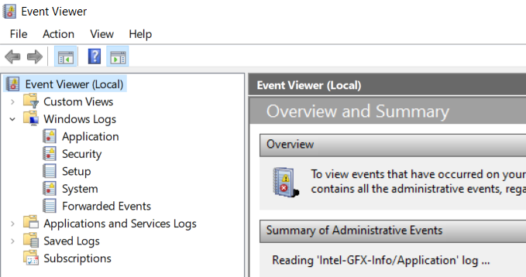
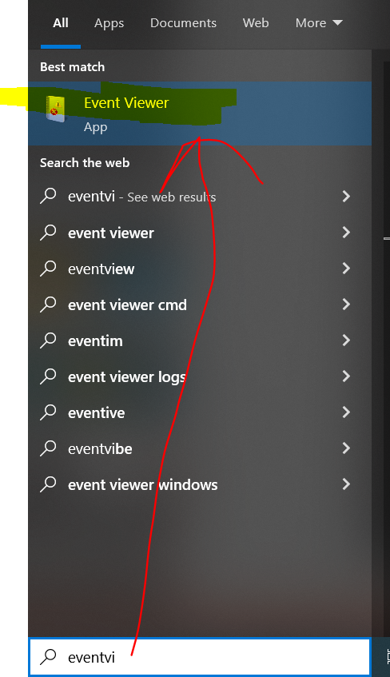
EventViewer

Slide 9
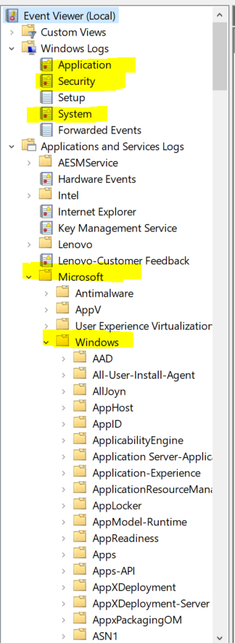
EventViewer

Slide 10
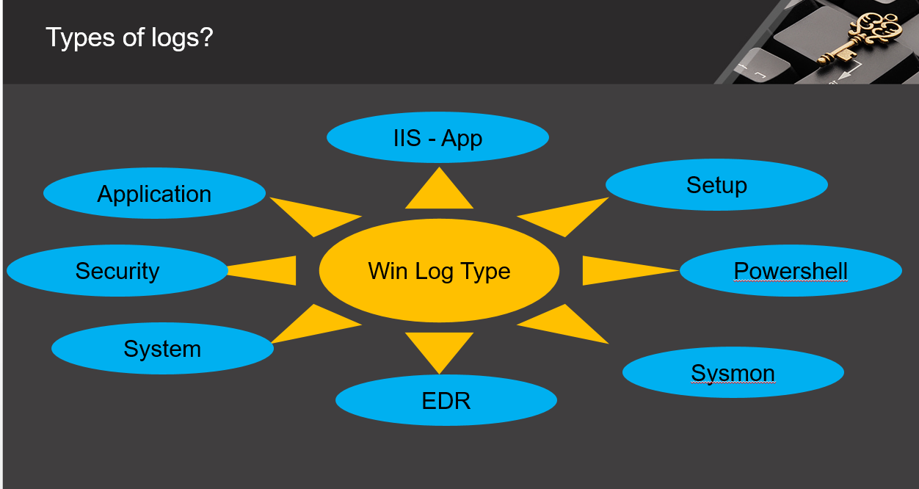
Possible Data sources based on types of logs
Log Source - Win
1
3
2

Slide 11
How to send logs towards syslog server / Collector / SIEM
Window Log Source
Syslog Server/ Log Collector / SIEM

Slide 12
Windows logs to Splunk SIEM
Window Log Source
Splunk Universal
Forwarder
Agent
SIEM - Splunk SIEM

Slide 13
Windows logs to IBM QRadar SIEM
Window Log Source
WinCollect Agent
SIEM – IBM QRadar

Slide 14
Solutions
Agent Based Solution – Push
Agentless Solution – Pull logs
Note : Each solution has pros and cons…

Slide 15
Vendors in market who provide agents
Window Log Source
WinCollect Agent
Splunk UF
Snare Agent
BalaBit Syslog
SIEM
NXLOG

Slide 16
Important EventID in Windows – might be useful to write security use cases
https://prophecyinternational.atlassian.net/wiki/spaces/WADOC/pages/1233224059/Appendix+C+-+Audit+Policies+and+Security+Event+IDs
https://andreafortuna.org/2019/06/12/windows-security-event-logs-my-own-cheatsheet/

Slide 17
Thank you

